Slide 1
Global Superstore

Slide 2
Contents
Objectives of the Presentation
Overview of Dataset
Graphs/ Results obtained
Conclusion

Slide 3
Overview of the Dataset
The dataset includes data for Sales of products sold by a company with information on geography, Product categories, subcategories, sales and profits, segmentation amongst the consumers etc.
The dataset overall consists of two sheets “Orders” and “Persons”
"Orders" worksheet consists of product orders across categories
“Persons” worksheet consists of names of managers of each region
The Global Superstore dataset is helpful to analyze and visualize the marketing and sales trends to derive key insights to ascertain future strategy

Slide 4
Objectives
1
Identify Sub-Category with Standard Deviation for Sales and Profit one point more than the Mean of Sales and Profit?
Identify Sub-Categories where Top 20 Customers have Sales more than the other Sub-Categories in the same Region.
Identify Regions where Top 20 Customers that have overall Profit Ratio (Profit as % of Sales) more than Profit Ratio of least profitable Sub-Category in the Region
Identify Managers whose Region Sales were greater than the Overall Average Sales?
2
3
4

Slide 5
Graphs & Results Obtained

Slide 6
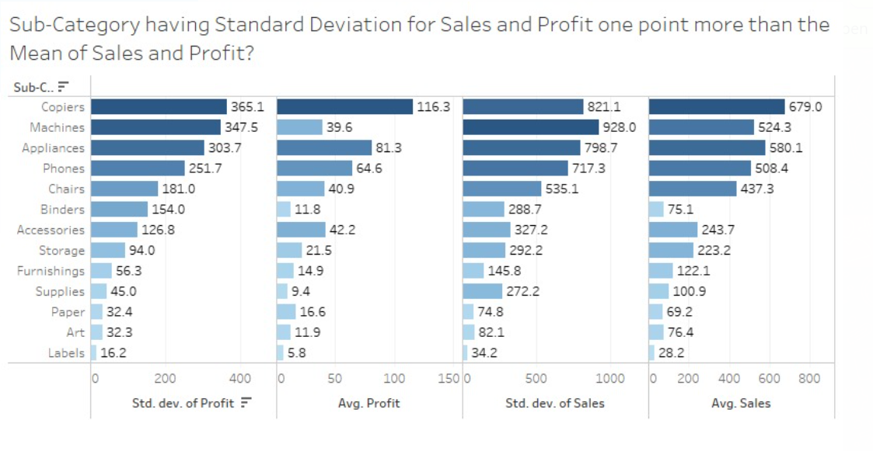
13 out of 17 categories with standard deviation greater than average for both Sales and Profit
1
“STDEV([Profit])>AVG([Profit])AND STDEV([Sales])>AVG([Sales])” applied on sub-categories to check for sub-categories with high variance of orders
Adjacent graph depicts sub-categories with variance of orders
High risk of orders seen across products as >75% of sub-categories have high variance
Average Profit, Average Sales, Standard Deviation of Profit and Standard Deviation of Sales across select sub-categories with standard deviation higher than average

Slide 7
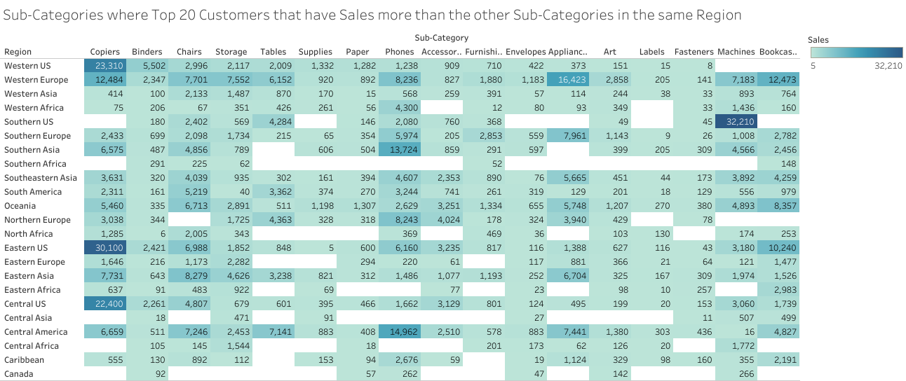
Copiers and phones top 2 sub-categories with top 2 customers having highest sales
2
Sales by sub-category x region for top 20 customers (by sales)
Copiers sub-category has highest sales in top 20 customers across 3 regions: Western US, Eastern US and Central US
Phones sub-category has highest sales in top 20 customers across 2 regions: Southern Asia and Central America

Slide 8
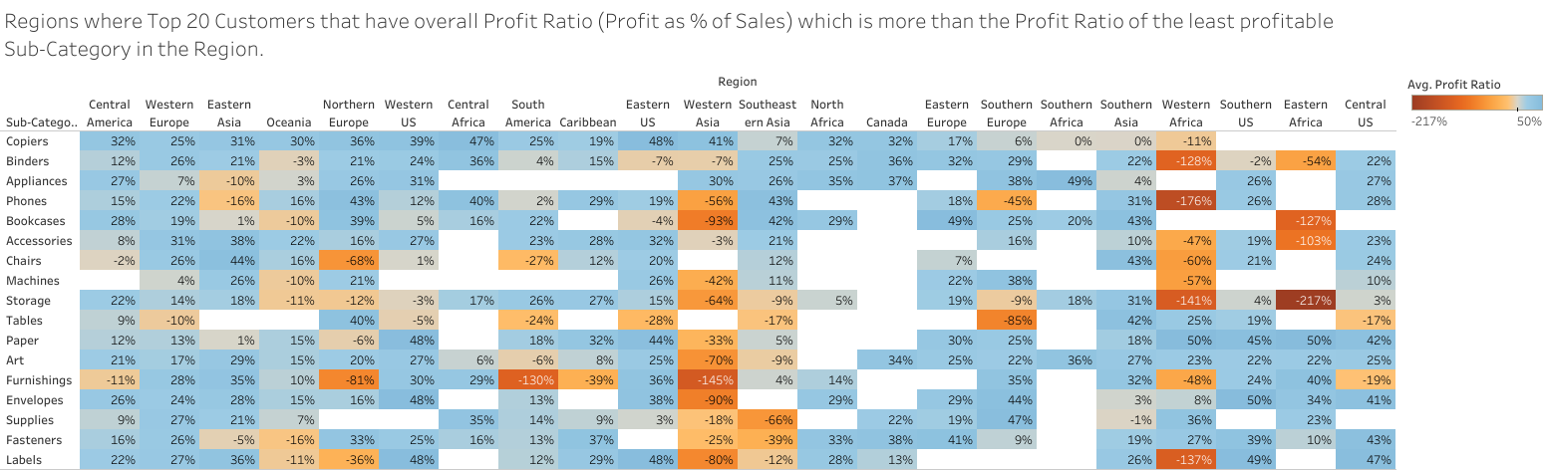
Central America and Western Europe among the most profitable regions
3
Profit Ratio by sub-category x region for sub-categories with higher than minimum profit ratio
Profit ratio defined by profit as % of sales
Central America and Western Europe among the most profitable regions with most sub-categories having better profit ratio than minimum
Table filtered with regions for which average profit ratio in top 20 customers greater than least profit ratio (sub-category)

Slide 9
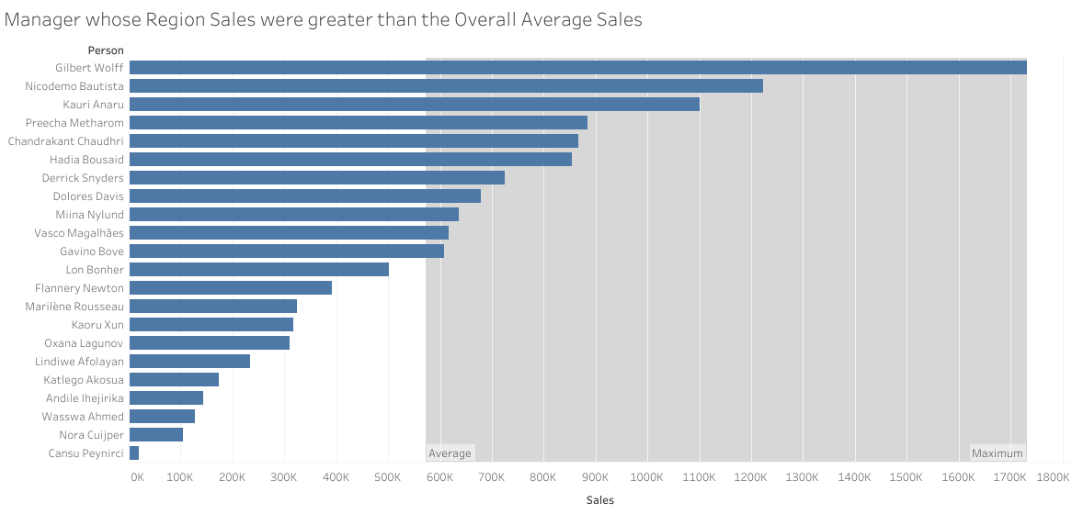
Gilbert Wolff is top manager among 11 managers whose region sales is greater than overall average sales
4
Regional Sales of managers
Grey area represents sales higher than overall average sales
Managers whose total sales is higher than average and falls under the grey region have above par performance, and those whose sales were unable to enter the grey region have a below par performance

Slide 10
Conclusion
The best performing sub-categories obtained from our first objectives are: Labels, Supplies, Binders, Art, Furnishings, Paper, Storage, Machines, Chairs, Accessories, Phones, Appliances, and Copiers.
The best performing Manager based upon total sales is Gilbert Wolff
The performance of sub-categories in various regions can be measured in terms of total sales as well as profit ratio.

